Slide 1
Obstacle Detection and Avoidance in Driverless Cars using Deep Learning
Guided by,
Mrs.Thasli Anzar
Asst. Professor
Dept. Of CSE
Presented by,
Ameera.Y(YCE19CS005)
Nishana Nizarkhan(YCE19CS025)
Thoufeek.T(YCE19CS035)

Slide 2
CONTENTS.
ABSTRACTION
INTRODUCTION.
PROBLEM DEFINITION.
TECHNOLOGY USED
LITERATURE REVIEW
MATERIALS AND METHODS
i) ALGORITHMS
ii) DATASET
DATA PRE-PROCESSING
RESULT AND DISCUSSION

Slide 3
ABSTRACT.
Artificial intelligence is one technology that would revolutionize the world as we know it and lead us head first into the future.
One of the applications of AI and a tranche of Computer vision is the autonomous self-driving car.
This robotic car might be today’s luxury but is surely tomorrow’s need.
By the advent of deep learning many neural networks-based learning approaches are under consideration.
This work tries to implement obstacle detection and avoidance in a self-driven car, One of advanced neural network called Convolutional Neural Network (CNN) is exploited for real time video/image analysis using an IOT device.
This project makes use of a raspberry pi which is responsible for controlling the car and performing inference using CNN.

Slide 4
INTRODUCTION.
A self-driving car is a vehicle that is capable of sensing its environment and moving with little or no human input.
In this monocular vision-based car, will get its input from the pi camera and a CNN model is used to take a decision accordingly.
Raspberry Pi has been used as a processing unit in this project, which takes the input through the raspberry pi camera and drives the car by sending control signals to the L293d driver module, which in turn controls the car.
The core of the project is the Convolutional Neural Network which maps the raw image pixels into features that detect objects and navigates the car.

Slide 5
PROBLEM DEFINITION.
Self-driving cars are already cruising the streets today.
And while these cars will ultimately be safer and cleaner than their manual counterparts, they can’t completely avoid accidents altogether.
The aim is not to survive a car accident but is to prevent it from happening.
This work tries to implement obstacle detection and avoidance in a self-driven car.
Also, how should the car be programmed if it encounters an unavoidable accident.

Slide 6
TECHNOLOGY USED.
SOFTWARE SIDE
Language : Python
Framework : TensorFlow
Test : Jupiter or Google Colab

Slide 7
literature review
SI no​ | Year​ | Name​ | Algorithm​ | Dataset | Result
1​ | 1983 | The Stanford cart and the CMU Rover​ | ​Path planning | Real time data | The system was reliable for short runs, but slow. The Cart moved 1 m every 10 to 15 min, in lurches. After rolling a meter it stopped, took some pictures, and thought about them for a long time. Then it planned a new path, executed a little of it, and paused again.
2​ | 2008 | Self-driving cars and the urban challenge.​ | NIL | GPS/INS Data | The team’s test schedule included over 3,000 km of autonomous operations in test sites in three different states. During qualifications, it consistently performed well, completing each evaluation course. The final event provided the most challenge, had to resort to using its error recovery system 11 times, but in the end finished about 20 minutes faster than its closest competitor.

Slide 8
literature review
SI no​ | Year​ | Name​ | Algorithm​ | Dataset | Result
3 | 2011 | Towards fully autonomous driving: Systems and algorithms.​ ​ | Unsupervised Algorithms | Real time data | With the previously described realtime algorithms operating in concert, this has been able to drive autonomously for hundreds of miles in a variety of lighting, weather, and traffic conditions. Challenges including narrow roads, crosswalks, and intersections governed by traffic lights are now manageable. However, it remains necessary for a safety driver to be present at all times, and they are not yet able to drive for hours on end without occasionally switching to manual control due to unexpected events.
4 | 2013 | Towards a visible autonomous driving research platforms.​ | Planning Algorithms | Real time data | The team’s test schedule included over 3,000 km of autonomous operations in test sites in three different states. During qualifications, it consistently performed well, completing each evaluation course. The final event provided the most challenge, had to resort to using its error recovery system 11 times, but in the end finished about 20 minutes faster than its closest competitor.

Slide 9
literature review
SI no​ | Year​ | Name​ | Algorithm​ | Dataset | Result
5 | 2014 | Public perceptions of self-driving cars: The case of Berkeley, California.​ ​ | NIL | No dataset(case study) | The convenience of a self-driving car is widely cited by study participants as major benefit of the technology and is not correlated to any specific group. Based on these results, self-driving technology manufacturers and advocates should emphasize the convenience and amenities that driverless cars offer in order to ensure widespread adoption.
6 | 2015 | Autonomous cars: Past, present and future a review of the developments in the last century, the present scenario and the expected future of autonomous vehicle technology | NIL | No dataset(Review paper) | This paper reviewed the historical antecedents, contemporary advancements and developments, and predictable future of semi and fully autonomous cars for public use.

Slide 10
literature review
SI no​ | Year​ | Name​ | Algorithm​ | Dataset | Result
7 | 2016 | Self-driving cars and the law | NIL | No dataset(Review paper) | self-driving cars will have a profound effect on city design. Parking spaces take up, on average, about 31 percent of city central business districts. Self-driving cars can park themselves in peripheral areas, or, in a shared-ownership/taxi model, they could pick up the next passenger. In either case, more land could be devoted to pedestrian zones, shopping, parks, and other valuable uses.
8 | 2016 | Speeding up Semantic Segmentation for Autonomous Driving | DNN | Cityscapes dataset | We evaluated the network on the test set using the official Cityscapes evaluation server. We achieve 59.8 per-class mean IoU and 84.3 per-category mean IoU.

Slide 11
literature review
SI no​ | Year​ | Name​ | Algorithm​ | Dataset | Result
9 | 2016 | End to end learning for self-driving cars | CNN | ILSVRC | In simulation test they had 10 interventions in 600 seconds, and have an autonomy value of 90% and for a typical drive 10 miles they were autonomous approximately 98% of the time with zero intercepts.
10 | 2018 | Real-Time Self-Driving Car Navigation Using Deep Neural Network | CNN | Real time data | The training process takes about 8 hours to train 50 epochs. When a model was trained with the aforementioned data, the training accuracy was 92.38% and the validation accuracy was 89.04%.

Slide 12
Materials And Methods
ALGORITHM
Convolutional neural networks(CNN) have become ubiquitous in computer vision.
CNN is most popular because of reliable results on object recognition and detection that are useful in real-world applications.
The typical use of convolutional networks is on classification tasks, where the output to an image is a single class label that needs to be classified.
Convolution is a function derived from two given functions by integration which expresses how the shape of one is modified by the other.
Unlike neural networks, the input to CNN is an image. The convolution layer comprises of a set of independent filters. The filter is slid over the complete image and the dot product is taken between the filter and chunks of the input image.
Each filter is independently convolved with the image and end up with feature maps. There are several uses that we gain from deriving a feature map, reducing the size of the image by preserving it’s semantic information is one of them.

Slide 13
ARCHITECTURE OF THE PROPOSED SYSTEM
Input from camera & sensor
Pre-processing
Convolutional layer
ReLu Layer
Output
Training and recognition
Fully connected Layer
Pooling layer

Slide 14
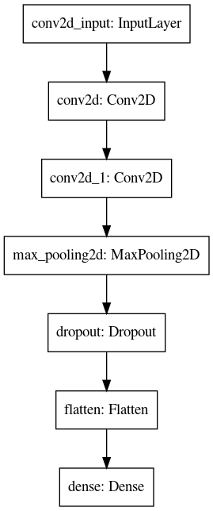
Convolutional Model Architecture:
The images are provided as an input to the model.
Using OpenCV the images are fed to the model.
The First layer of the model is a convolution layer consists of 32 filters of size/dimension 3x3, followed by a dropout layer of 20%, the dropout will avoid the overfitting of the model.
Then another convolution layer of 64 filters with 3x3 dimension.
A Max pooling of 2x2 is applied, as it reduces the dimensionality and allows assumptions to be made about features contained in the sub-regions binned.
After max pooling, a dropout of 20% is applied followed by a flattening layer which will convert a 3D image to a 1d array.
The dense layer of 128 neurons with a ReLu activation is applied.
Finally, the output (dense) layer consists of 4 outputs with Softmax activation. We are estimating the losses using categorical cross-entropy and we used Adam optimizer of the model since it is the best optimizer that provides reliable results

Slide 15

Materials And Methods
DATASET
For Building a Neural network model we need lots of data.
The data will be collecting during the training process.
Initially, the car needs to be controlled wirelessly.
To do that we will use VNC viewer which will enable us to control Raspberry Pi wirelessly through Wi-fi in devices such as laptop and smartphones.
Next is to build a track so that we can train the car. As we run the car on the track it will collect the image data through the raspberry pi camera and the input command (forward, stop, right, left). This data will be used to train the neural network model.

Slide 16
Datasets drive vision progress, yet existing driving datasets are limited in terms of visual content, scene variation, the richness of annotations, and the geographic distribution and supported tasks to study multitask learning for autonomous driving.
In 2018 Yu et al. released BDD100K, the largest driving dataset with 100K videos, images and 10 tasks to evaluate the progress of image recognition algorithms on autonomous driving.
The dataset possesses geographic, environmental, and weather diversity, which is useful for training models that are less likely to be surprised by new conditions.
Provided are bounding box annotations of 13 categories for each of the reference frames of 100K videos and 2D bounding boxes annotated on 100.000 images for "other vehicle", "pedestrian", "traffic light", "traffic sign", "truck", "train", "other person", "bus", "car", "rider", "motorcycle", "bicycle", "trailer".
The goal of our project is to detect and avoid obstacles in a video in real-time. We are using the Berkeley DeepDrive dataset to train the model.

Slide 17
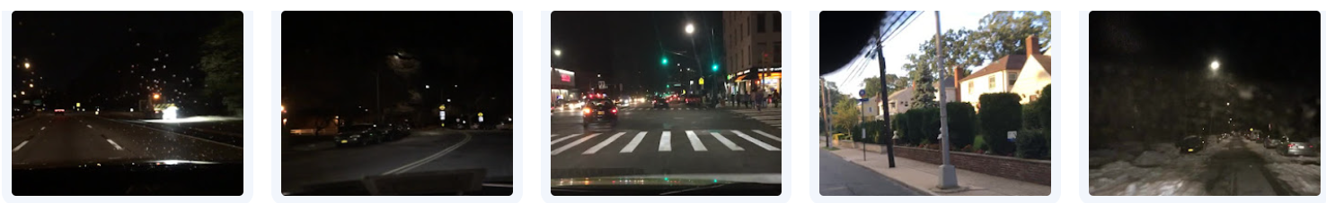
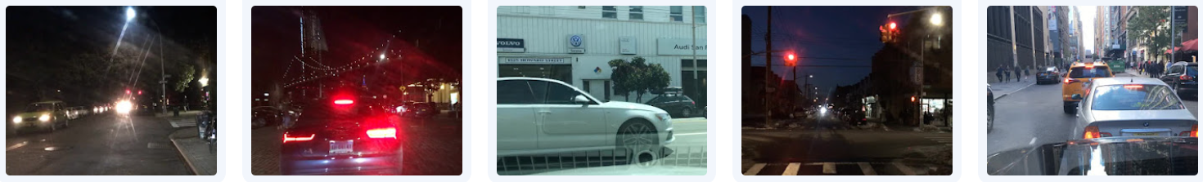
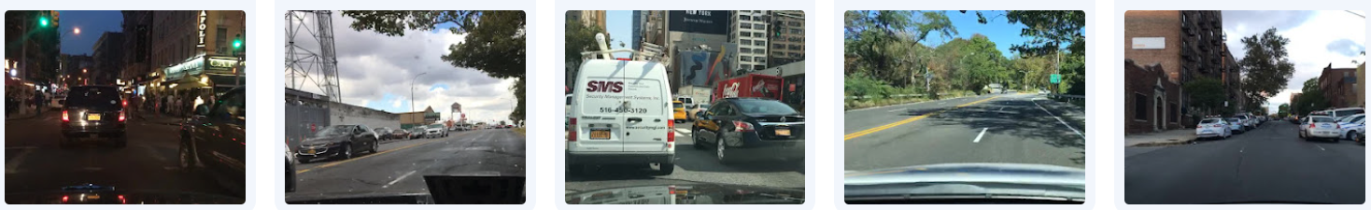
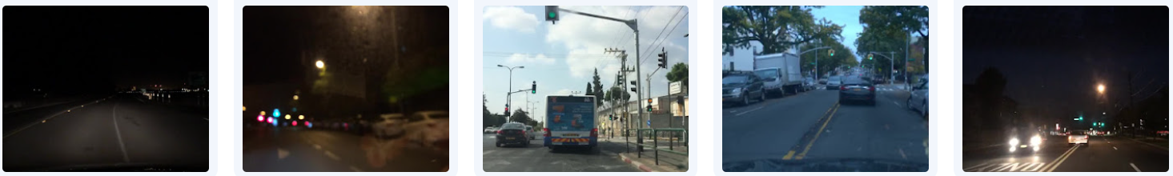
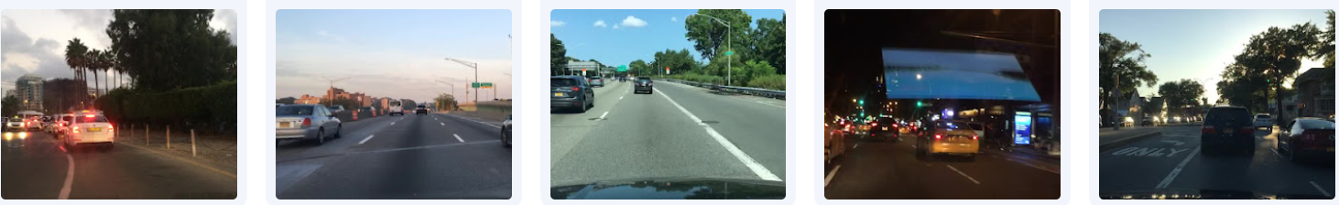
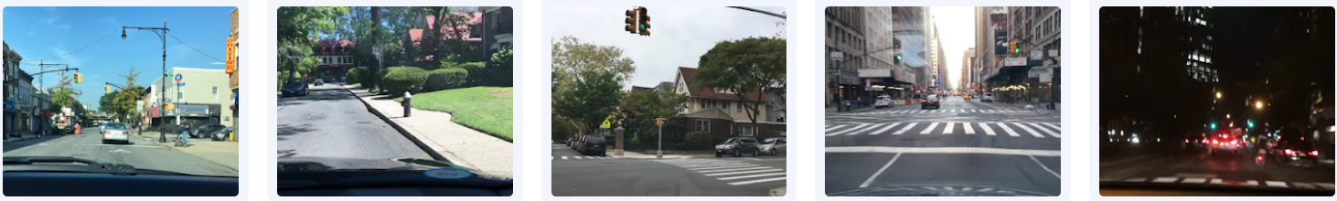
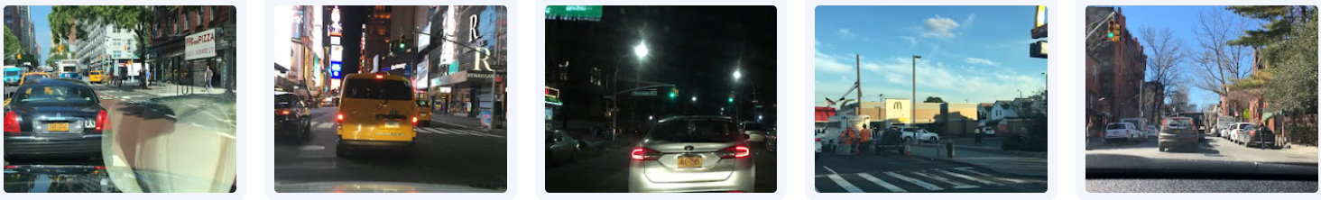
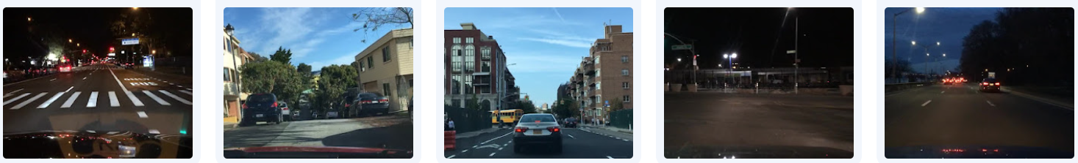
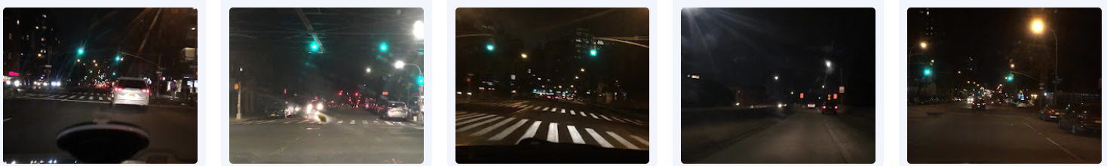
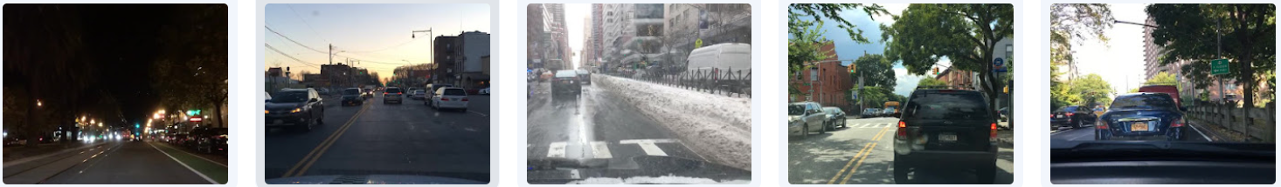
D
A
T
A
S
E
T

Slide 18
Data pre-processing
Data pre-processing is an important step that helps to prepare the input data for the CNN model.
The pre-processing step involves in this project is :
Data collection: Data is collected from various sources, such as cameras and other sensors. The data is typically in the form of images or point clouds.
Normalization: The input data is normalized to ensure that all the input features have similar scales. This helps to prevent the CNN model from being biased towards certain features.
Feature extraction: In this stage, features are extracted from the input data using techniques such as edge detection, corner detection, and other image processing techniques. The extracted features are then used as input to the CNN model.

Slide 19
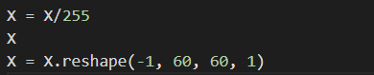
The above code snippet is used for pre-processing in the proposed project
The first line of code X = X/255 is used to normalize the pixel values of the image to a range between 0 and 1, which is a common preprocessing step in image analysis and machine learning.
The second line of code X is just used to print the updated array X.
The third line of code X = X.reshape(-1, 60, 60, 1) reshapes the input image data to a 4D tensor with dimensions (batch_size, height, width, channels), where batch_size is inferred from the size of the input data, height and width correspond to the size of the input image, and channels is set to 1 in this case, as the input images are grayscale. This reshaping is necessary for feeding the image data to a deep learning model, as most image-based models expect the input data to be in this format.

Slide 20
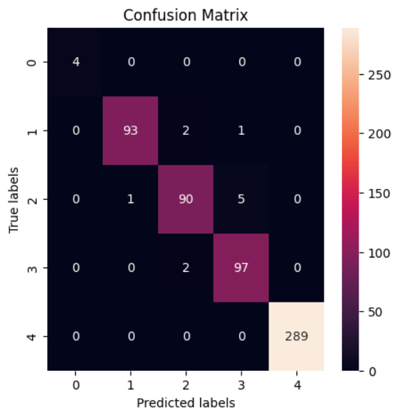
Results and Discussion
CONFUSION MATRIX OF THE PROPOSED MODEL

Slide 21
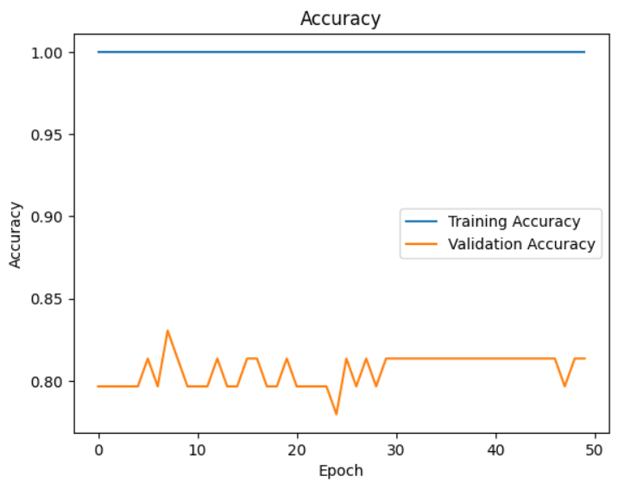
Results and Discussion
ACCURACY OF THE PROPOSED MODEL

Slide 22
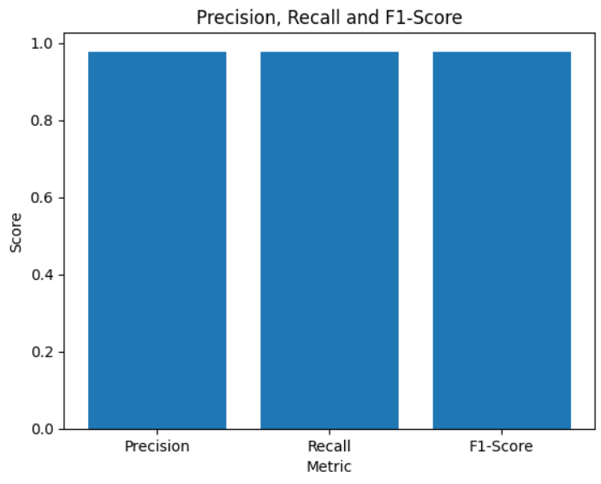
Results and Discussion
PRECISION,RECALL AND F1_SCORE OF THE PROPOSED MODEL

Slide 23
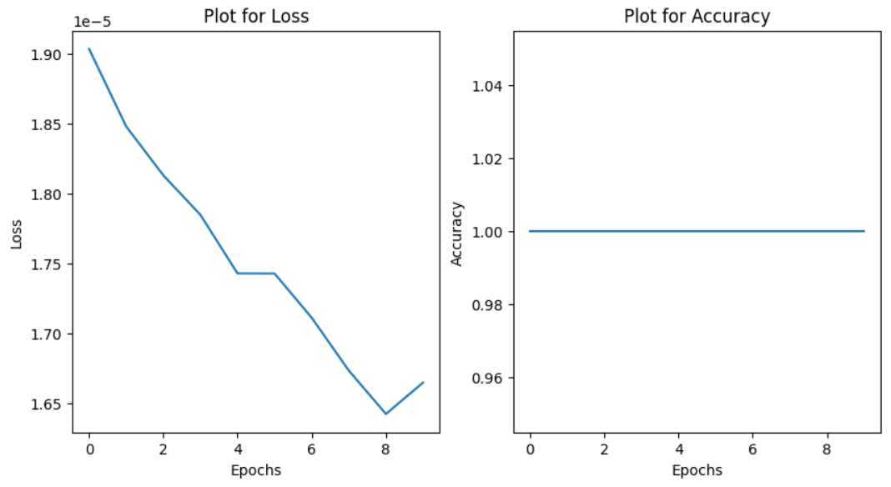
Results and Discussion
PLOT FOR LOSS AND ACCURACY OF THE PROPOSED MODEL

Slide 24
REFERENCE
[1] Sanil, Nischal, et al. "Deep learning techniques for obstacle detection and avoidance in driverless cars." 2020 International Conference on Artificial Intelligence and Signal Processing (AISP). IEEE, 2020.
[2] Greenblatt, Nathan A. ”Self-driving cars and the law.” IEEE spectrum 53.2 (2016): 46-51.
[3] Do, Truong-Dong, et al. ”Real-Time Self-Driving Car Navigation Using Deep Neural Network.” 2018 4th International Conference on Green Technology and Sustainable Development (GTSD). IEEE, 2018.
[4] Howard, Daniel, and Danielle Dai. ”Public perceptions of self-driving cars: The case of Berkeley, California.” Transportation Research Board 93rd Annual Meeting. Vol. 14. No. 4502. 2014.
[5] Urmson, Chris. ”Self-driving cars and the urban challenge.” IEEE Intelligent Systems 23.2 (2008): 66-68.
[6] Bimbraw, Keshav. ”Autonomous cars: Past, present and future a review of the developments in the last century, the present scenario and the expected future of autonomous vehicle technology.” 2015 12th International Conference on Informatics in Control, Automation and Robotics (ICINCO). Vol. 1. IEEE, 2015.

Slide 25
[7] Treml, Michael, et al. ”Speeding up semantic segmentation for autonomous driving.” MLITS, NIPS Workshop. Vol. 1. 2016.
[8] Levinson, Jesse, et al. ”Towards fully autonomous driving: Systems and algorithms.” 2011 IEEE Intelligent Vehicles Symposium (IV). IEEE, 2011.
[9] Moravec, Hans P. ”The stanford cart and the CMU rover.” Autonomous Robot Vehicles. Springer, New York, NY, 1990. 407-419., Hans P. ”The stanford cart and the CMU rover.” Autonomous Robot Vehicles. Springer, New York, NY, 1990. 407-419.
[10] Bojarski, Mariusz, et al. ”End to end learning for self-driving cars.” arXiv preprint arXiv:1604.07316 (2016).
[11]Wei, Junqing, et al. ”Towards a viable autonomous driving research platform.” 2013 IEEE Intelligent Vehicles Symposium (IV). IEEE, 2013.

Slide 26
THANK YOU

